Slide 1
Software Evolution

Slide 2
Review {Testing}
Validation & Verification
Inspection & Testing
Stages of Testing
Development Testing: Unit, Component and System Testing
Release Testing: Requirements testing, Performance Testing
User Testing: Alpha, Beta and Acceptance Testing
Test Driven Development

Slide 4
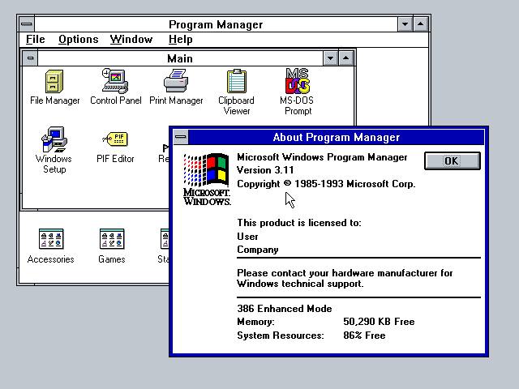
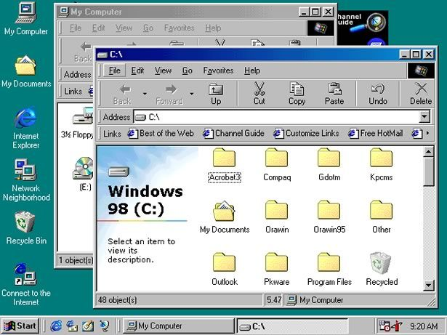
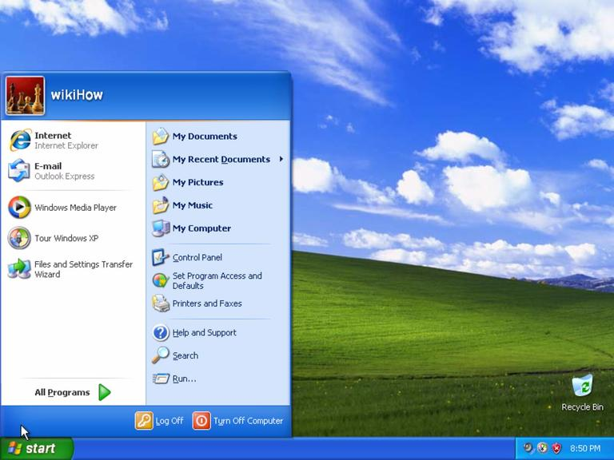
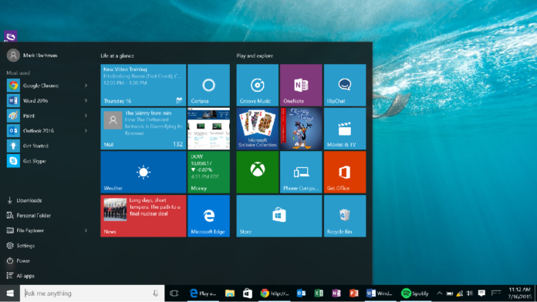
Evolution
Windows 3.11
Windows 98
Windows XP
Windows 10

Slide 5
Software change
Software change is inevitable
New requirements emerge when the software is used;
Errors must be repaired;
New computers and equipment is added to the system;
The performance or reliability of the system may have to be improved.
Systems are tightly coupled with their environment. When a system is installed in an environment it changes that environment and therefore changes the system requirements.
Systems MUST be changed if they are to remain useful in an environment.
A key problem for all organizations is implementing and managing change to their existing software systems.

Slide 6
Importance of evolution
Organizations have huge investments in their software systems - they are critical business assets.
To maintain the value of these assets to the business, they must be changed and updated.
The majority of the software budget in large companies is devoted to changing and evolving existing software rather than developing new software.

Slide 7
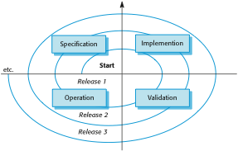
A spiral model of development and evolution

Slide 8

Stages of Software

Slide 9
Stages of Software
Evolution
The stage in a software system’s life cycle where it is in operational use and is evolving as new requirements are proposed and implemented in the system.
Servicing
At this stage, the software remains useful but the only changes made are those required to keep it operational i.e. bug fixes and changes to reflect changes in the software’s environment. No new functionality is added.
Phase-out
The software may still be used but no further changes are made to it.

Slide 10
Evolution processes
Software evolution processes depend on
The type of software being maintained;
The development processes used;
The skills and experience of the people involved.
Proposals for change are the driver for system evolution.
Should be linked with components that are affected by the change, thus allowing the cost and impact of the change to be estimated.
Change identification and evolution continues throughout the system lifetime.

Slide 11
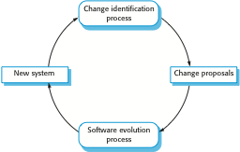
Change identification and evolution processes

Slide 12
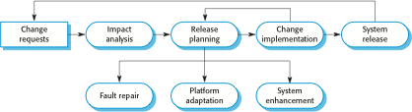
The software evolution process

Slide 13

Change implementation

Slide 14
Change implementation
Iteration of the development process where the revisions to the system are designed, implemented and tested.
The first stage of change implementation may involve program understanding, especially if the original system developers are not responsible for the change implementation.
During the program understanding phase, you have to understand how the program is structured, how it delivers functionality and how the proposed change might affect the program.

Slide 15
Urgent change requests
Urgent changes may have to be implemented without going through all stages of the software engineering process
If a serious system fault has to be repaired to allow normal operation to continue;
If changes to the system’s environment (e.g. an OS upgrade) have unexpected effects;
If there are business changes that require a very rapid response

Slide 16
The emergency repair process

Slide 17
Agile methods and evolution
Agile methods are based on incremental development so the transition from development to evolution is a seamless one.
Evolution is simply a continuation of the development process based on frequent system releases.
Changes may be expressed as additional user stories.

Slide 18
Program evolution dynamics
Program evolution dynamics is the study of the processes of system change.
After several major empirical studies, Lehman and Belady proposed that there were a number of ‘laws’ which applied to all systems as they evolved.
There are sensible observations rather than laws. They are applicable to large systems developed by large organisations.

Slide 19
Lehman’s laws
Law | Description
Continuing change | A program that is used in a real-world environment must necessarily change, or else become progressively less useful in that environment.
Increasing complexity | As an evolving program changes, its structure tends to become more complex. Extra resources must be devoted to preserving and simplifying the structure.
Large program evolution | Program evolution is a self-regulating process. System attributes such as size, time between releases, and the number of reported errors is approximately invariant for each system release.
Organizational stability | Over a program’s lifetime, its rate of development is approximately constant and independent of the resources devoted to system development.

Slide 20
Lehman’s laws
Law | Description
Conservation of familiarity | Over the lifetime of a system, the incremental change in each release is approximately constant.
Continuing growth | The functionality offered by systems has to continually increase to maintain user satisfaction.
Declining quality | The quality of systems will decline unless they are modified to reflect changes in their operational environment.
Feedback system | Evolution processes incorporate multi-agent, multi-loop feedback systems and you have to treat them as feedback systems to achieve significant product improvement.

Slide 21
Software maintenance
Modifying a program after it has been put into use.
The term is mostly used for changing custom software.
Generic software products are said to evolve to create new versions.
Maintenance does not normally involve major changes to the system’s architecture.
Changes are implemented by modifying existing components and adding new components to the system.

Slide 22
Types of maintenance
Maintenance to repair software faults
Changing a system to correct deficiencies (Corrective)
Changing a system to correct potential deficiencies (Preventive)
Maintenance to adapt software to a different operating environment
Changing a system so that it operates in a different environment (computer, OS, etc.) from its initial implementation (Adaptive)
Maintenance to add to or modify the system’s functionality
Modifying the system to satisfy new requirements (Perfective)

Slide 23
Maintenance costs
Usually greater than development costs (2* to 100* depending on the application).
Affected by both technical and non-technical factors.
Increases as software is maintained. Maintenance may corrupt the software structure so makes further maintenance more difficult.
Ageing software can have high support costs (e.g. old languages, compilers etc.).

Slide 24
Maintenance cost factors
Team stability
Maintenance costs are reduced if the same staff are involved with them for some time.
Contractual responsibility
The developers of a system may have no contractual responsibility for maintenance so there is no incentive to design for future change.
Staff skills
Maintenance staff are often inexperienced and have limited domain knowledge.
Program age and structure
As programs age, their structure is degraded and they become harder to understand and change.

Slide 25
System re-engineering
Re-structuring or re-writing part or all of a legacy system without changing its functionality.
Applicable where some but not all sub-systems of a larger system require frequent maintenance.
Re-engineering involves adding effort to make them easier to maintain. The system may be re-structured and re-documented.

Slide 26
Advantages of reengineering
Reduced risk
There is a high risk in new software development. There may be development problems, staffing problems and specification problems.
Reduced cost
The cost of re-engineering is often significantly less than the costs of developing new software.

Slide 27
Reengineering process activities
Source code translation
Convert code to a new language.
Reverse engineering
Analyze the program to understand it;
Program structure improvement
Restructure for understandability;
Program modularization
Reorganize the program structure;
Data reengineering
Clean-up and restructure system data.

Slide 28
Reengineering cost factors
The quality of the software to be reengineered.
The tool support available for reengineering.
The extent of the data conversion which is required.
The availability of expert staff for reengineering.
This can be a problem with old systems based on technology that is no longer widely used.

Slide 29
Preventative maintenance by refactoring
Refactoring is the process of making improvements to a program to slow down degradation through change.
You can think of refactoring as ‘preventative maintenance’ that reduces the problems of future change.
Refactoring involves modifying a program to improve its structure, reduce its complexity or make it easier to understand.
When you refactor a program, you should not add functionality but rather concentrate on program improvement.

Slide 30
Refactoring and reengineering
Re-engineering takes place after a system has been maintained for some time and maintenance costs are increasing.
Refactoring is a continuous process of improvement throughout the development and evolution process. It is intended to avoid the structure and code degradation that increases the costs and difficulties of maintaining a system.

Slide 31
Legacy system management
Organisations that rely on legacy systems must choose a strategy for evolving these systems
Scrap the system completely and modify business processes so that it is no longer required;
Continue maintaining the system;
Transform the system by re-engineering to improve its maintainability;
Replace the system with a new system.
The strategy chosen should depend on the system quality and its business value.

Slide 32
Legacy system categories
Low quality, low business value
These systems should be scrapped.
Low-quality, high-business value
These make an important business contribution but are expensive to maintain. Should be re-engineered or replaced if a suitable system is available.
High-quality, low-business value
Replace with COTS, scrap completely or maintain.
High-quality, high business value
Continue in operation using normal system maintenance.

Slide 33
Business value assessment
Assessment should take different viewpoints into account
System end-users;
Business customers;
Line managers;
IT managers;
Senior managers.
Interview different stakeholders and collate results.

Slide 34
Issues in business value assessment
The use of the system
If systems are only used occasionally or by a small number of people, they may have a low business value.
The business processes that are supported
A system may have a low business value if it forces the use of inefficient business processes.
System dependability
If a system is not dependable and the problems directly affect business customers, the system has a low business value.
The system outputs
If the business depends on system outputs, then the system has a high business value.

Slide 35
System quality assessment
Business process assessment
How well does the business process support the current goals of the business?
Environment assessment
How effective is the system’s environment and how expensive is it to maintain?
Application assessment
What is the quality of the application software system?

